Slide 1
Introduction to Java
By : Neha P. Rajas
Asst. Prof. ICEM

Slide 2
Contents
What is JAVA?
Brief History of Java
Where Java is mostly used
Characteristics of JAVA
Application of Java
Java Life Cycle
A Simple JAVA Program
Java Disadvantages

Slide 3
What is JAVA?
James Gosling is Father of Java.
James Gosling & Patrick Naughton at 1990
Goal :
to develop distributed system which is applicable to electronic products(platform independent)

Slide 4
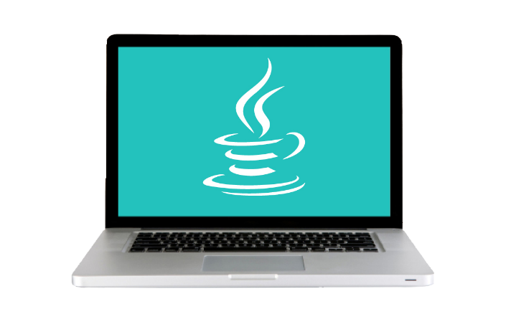

A programming language and computing platform
Developed By
W.O.R.A
Write
Once
Run
Anywhere
Principle
From laptops to datacentres, game consoles to scientific supercomputers, cell phones to the Internet, Java is everywhere!

Slide 5
Brief History of Java
In 1990, Sun Microsystems began an internal project known as the
Green Project to work on a new technology.
In 1992, the Green Project was spun off and its interest directed
toward building highly interactive devices for the cable TV industry.
This failed to materialize.
In 1994, the focus of the original team was re-targeted, this time to
the use of Internet technology. A small web browser called HotJava
was written.
Oak was renamed to Java after learning that Oak had already been trademarked.

Slide 6
JDK Versions
•JDK 1.02 (1995) … 250 classes
•JDK 1.1 (1996) … 500 classes
•JDK 1.2 (1998) … 2300 classes
•JDK 1.3 (2000) … 2300 classes
•JDK 1.4 (2002) … 2300 classes
•JDK 1.5 (2004) … 3500 classes
•JDK 1.6 (2006) … 3500 classes
•JDK 1.7 (2011) … 3500 classes

Slide 7


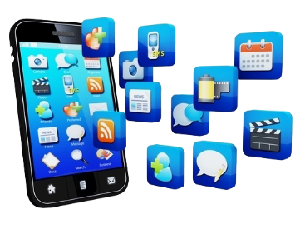
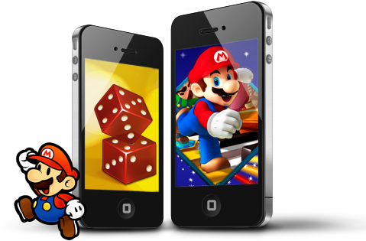

Where Java is mostly used
80% of Android uses Java
Web applications e.g Google docs
Build mobile apps
Hadoop
Build mobile games

Slide 8
Characteristics of Java
•Java Is Simple
•Java Is Object-Oriented
•Java Is Distributed
•Java Is Interpreted
•Java Is Robust
•Java Is Secure
•Java Is Architecture-Neutral
•Java Is Portable
•Java's Performance
•Java Is Multithreaded
•Java Is Dynamic

Slide 9
Characteristics of Java
Java is partially modeled on C++, but
greatly simplified and improved. Some
people refer to Java as "C++--" because it is like C++ but with more functionality and fewer negative aspects.
Java Is Simple
•Java Is Object-Oriented
•Java Is Distributed
•Java Is Interpreted
•Java Is Robust
•Java Is Secure
•Java Is Architecture-Neutral
•Java Is Portable
•Java's Performance
•Java Is Multithreaded
•Java Is Dynamic

Slide 10
Characteristics of Java
Java Is Simple
Java Is Object-Oriented
•Java Is Distributed
•Java Is Interpreted
•Java Is Robust
•Java Is Secure
•Java Is Architecture-Neutral
•Java Is Portable
•Java's Performance
•Java Is Multithreaded
•Java Is Dynamic
Object-oriented programming provides great flexibility, modularity, clarity, and reusability through encapsulation, inheritance, and polymorphism.

Slide 11
Characteristics of Java
Java Is Simple
Java Is Object-Oriented
Java Is Distributed
•Java Is Interpreted
•Java Is Robust
•Java Is Secure
•Java Is Architecture-Neutral
•Java Is Portable
•Java's Performance
•Java Is Multithreaded
•Java Is Dynamic
Distributed computing involves several computers working together on a network. Java is designed to make distributed computing easy. Since networking capability is inherently
integrated into Java.

Slide 12
Characteristics of Java
Java Is Simple
Java Is Object-Oriented
Java Is Distributed
Java Is Interpreted
•Java Is Robust
•Java Is Secure
•Java Is Architecture-Neutral
•Java Is Portable
•Java's Performance
•Java Is Multithreaded
•Java Is Dynamic
You need an interpreter to run Java
programs. The programs are compiled
into the Java Virtual Machine code
called bytecode. The bytecode is
machine-independent and can run on any machine that has a Java
interpreter, which is part of the Java
Virtual Machine (JVM).

Slide 13
Characteristics of Java
Java Is Simple
Java Is Object-Oriented
Java Is Distributed
Java Is Interpreted
Java Is Robust
•Java Is Secure
•Java Is Architecture-Neutral
•Java Is Portable
•Java's Performance
•Java Is Multithreaded
•Java Is Dynamic
Java has a runtime exception-handling feature to provide programming support for robustness

Slide 14
Characteristics of Java
Java Is Simple
Java Is Object-Oriented
Java Is Distributed
Java Is Interpreted
Java Is Robust
Java Is Secure
•Java Is Architecture-Neutral
•Java Is Portable
•Java's Performance
•Java Is Multithreaded
•Java Is Dynamic
Java implements several security mechanisms to protect your system against harm caused by stray programs

Slide 15
Characteristics of Java
Java Is Simple
Java Is Object-Oriented
Java Is Distributed
Java Is Interpreted
Java Is Robust
Java Is Secure
Java Is Architecture-Neutral
•Java Is Portable
•Java's Performance
•Java Is Multithreaded
•Java Is Dynamic
Write once, run anywhere
With a Java Virtual Machine (JVM), you can write one program that will run on any platform

Slide 16
Characteristics of Java
Java Is Simple
Java Is Object-Oriented
Java Is Distributed
Java Is Interpreted
Java Is Robust
Java Is Secure
Java Is Architecture-Neutral
Java Is Portable
•Java's Performance
•Java Is Multithreaded
•Java Is Dynamic
Because Java is architecture neutral, Java programs are portable. They can be run on any platform without being recompiled

Slide 17
Characteristics of Java
Java Is Simple
Java Is Object-Oriented
Java Is Distributed
Java Is Interpreted
Java Is Robust
Java Is Secure
Java Is Architecture-Neutral
Java Is Portable
Java's Performance
•Java Is Multithreaded
•Java Is Dynamic
Java’s performance Because Java is
architecture neutral, Java programs areportable. They can be run on any
platform without being recompiled.

Slide 18
Characteristics of Java
Java Is Simple
Java Is Object-Oriented
Java Is Distributed
Java Is Interpreted
Java Is Robust
Java Is Secure
Java Is Architecture-Neutral
Java Is Portable
Java's Performance
Java Is Multithreaded
•Java Is Dynamic
Multithread programming is smoothly integrated in Java, whereas in other languages you have to call procedures specific to the operating system to enable multithreading.

Slide 19
Characteristics of Java
Java Is Simple
Java Is Object-Oriented
Java Is Distributed
Java Is Interpreted
Java Is Robust
Java Is Secure
Java Is Architecture-Neutral
Java Is Portable
Java's Performance
Java Is Multithreaded
Java Is Dynamic
Java was designed to adapt to an evolving environment. New code can be loaded on the fly without recompilation. New features can be incorporated transparently as needed.

Slide 20
Java Application
1. Java 2 Platform, Standard Edition (J2SE)
Core Java Platform targeting applications running on
workstations
2. Java 2 Platform, Enterprise Edition (J2EE)
Component-based approach to developing distributed,
multi-tier enterprise applications
3. Java 2 Platform, Micro Edition (J2ME)
Targeted at small, stand-alone or connectable
consumer and embedded devices

Slide 21
Java Life Cycle
Java programs normally undergo four phases
• Edit
Programmer writes program (and stores program on disk)
• Compile
Compiler creates byte-codes from program (.class)
•Load
Class loader stores byte-codes in memory
• Execute
Interpreter: translates byte-codes into machine language

Slide 22
Simple Java Program
This program prints Welcome to Java!
public class Welcome
{
public static void main(String[] args)
{
System.out.println("Welcome to Java!");
}
}

Slide 23
Java Disadvantages
• Slower than compiled language such as C
an experiment in 1999 showed that Java was 3 or 4
times slower than C or C++

